Slide 1
Exercise
Let us learn how to use Docker on cloud (AWS)

Slide 2
AWS and Docker

Slide 3
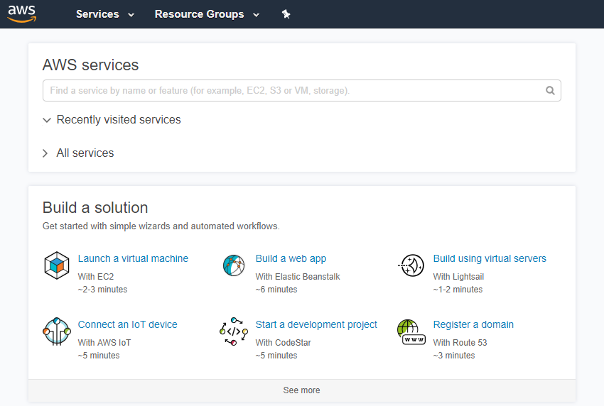
Login to AWS & Navigate to Home Page

Slide 4
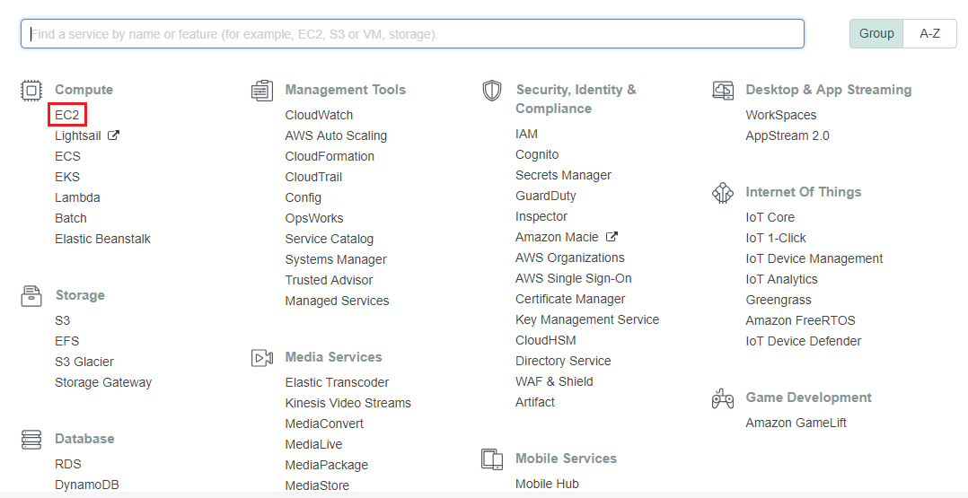
Invoking EC2

Slide 5
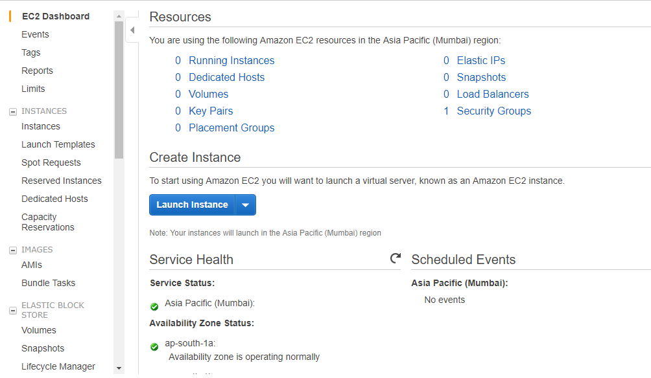
EC2 Dashboard
Click Launch Instance

Slide 6
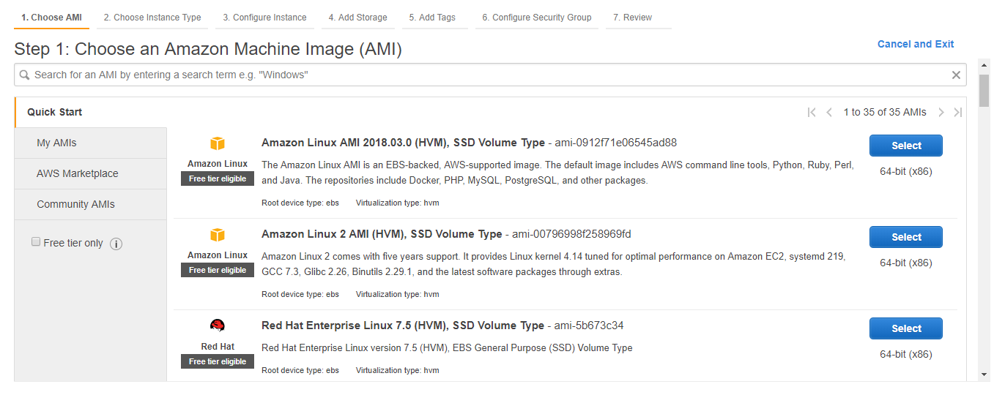
Choosing an AMI

Slide 7
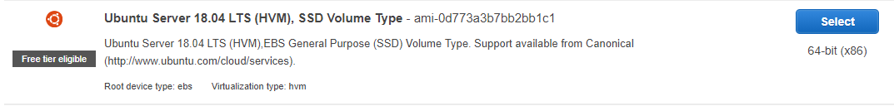
Choosing Ubuntu Image Do not use any other image
Click Select

Slide 8
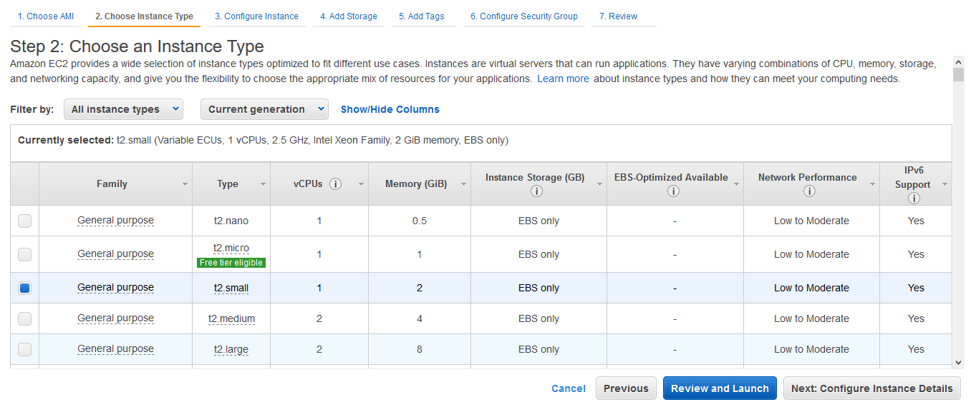
Choosing Instance Type(t2.small)
Click Next: Configure Instance Details

Slide 9
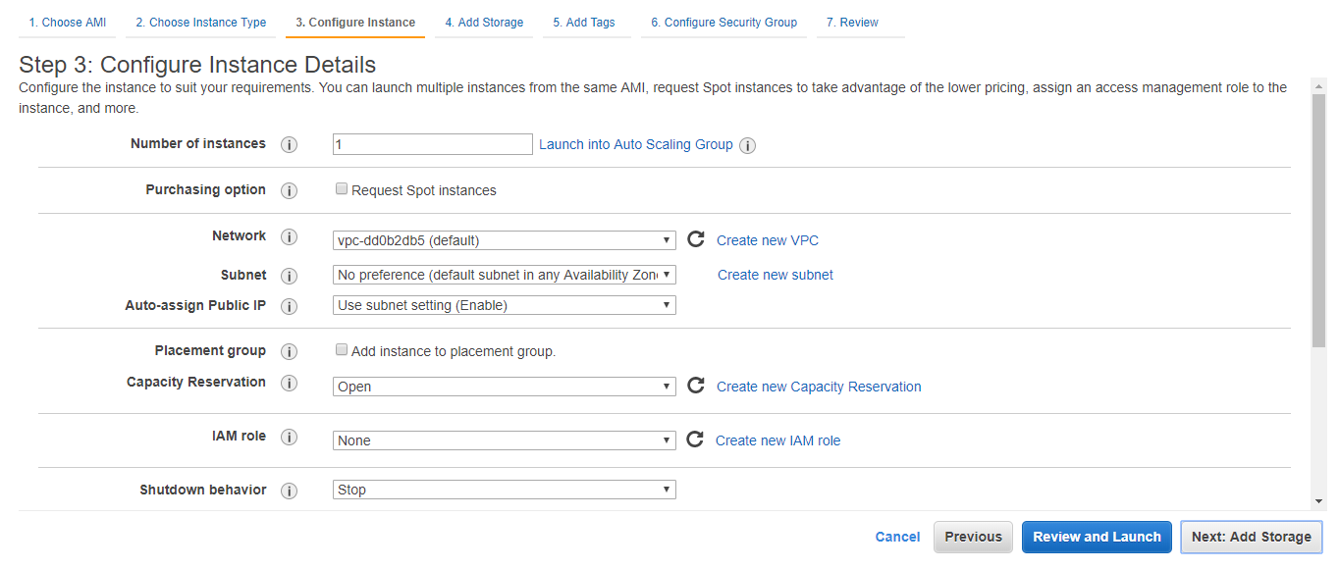
Configuring Instance Details(Keep as default)
Click Next: Add Storage

Slide 10
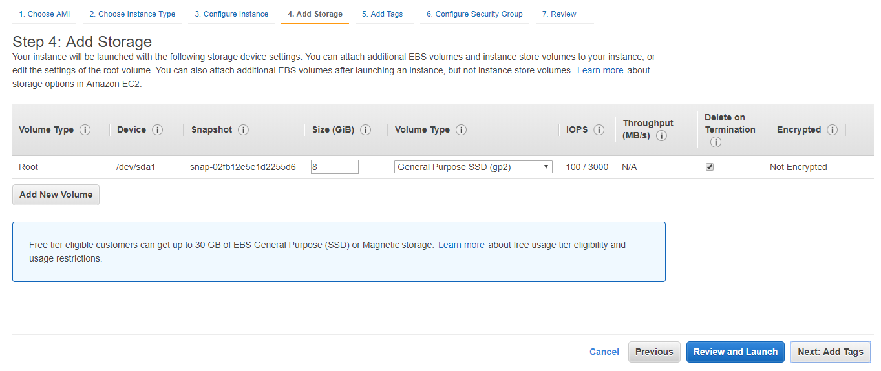
Adding Storage(Keep as default)
Click Next: Add Tags

Slide 11
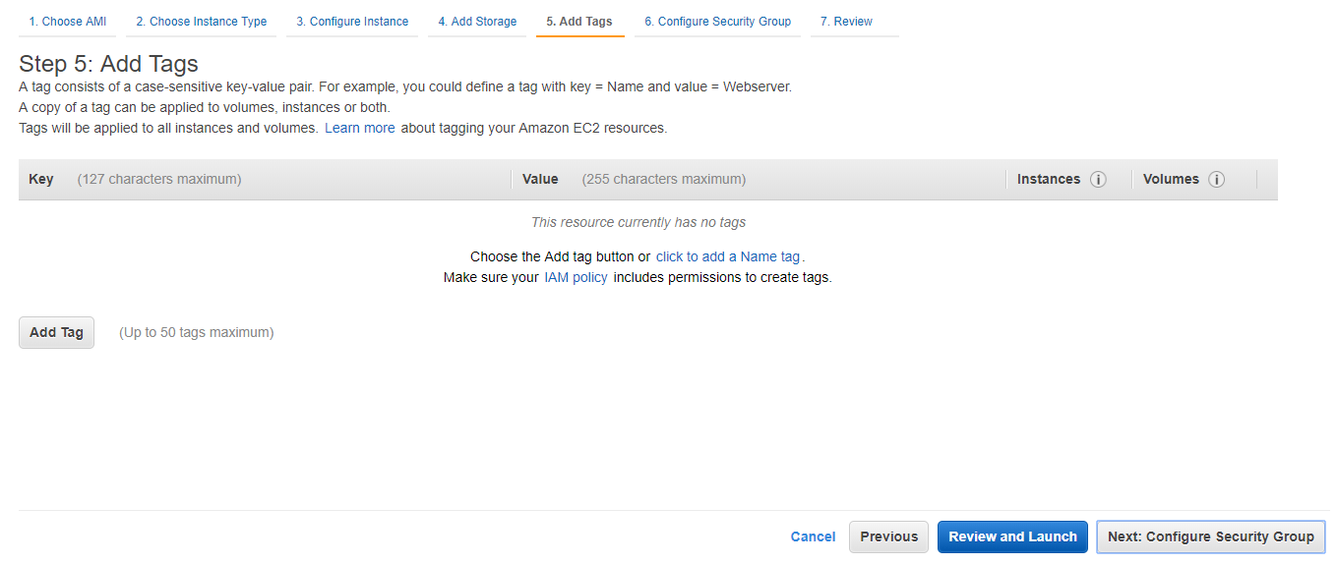
Adding Tags(Keep as default)
Click Next: Configure Security Group

Slide 12
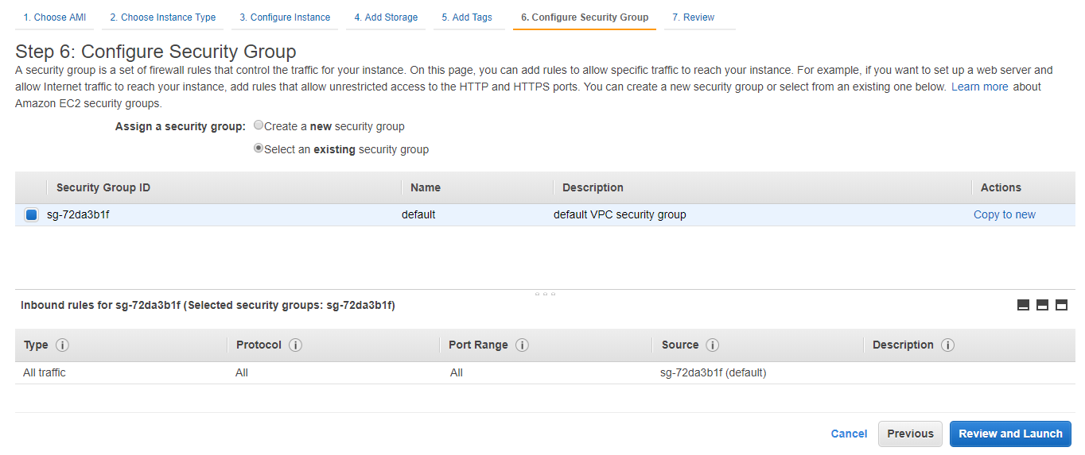
Configuring Security Group(Keep as default)
Click Review and Launch

Slide 13
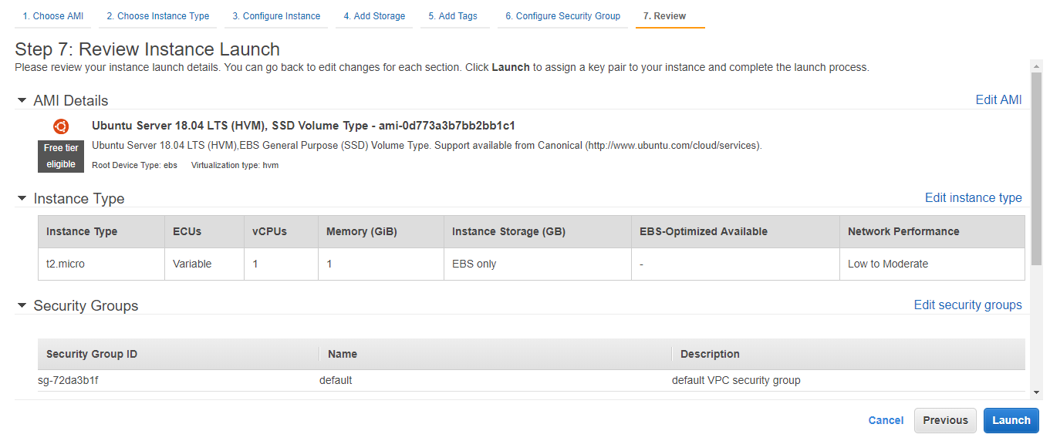
Reviewing
Click Launch

Slide 14
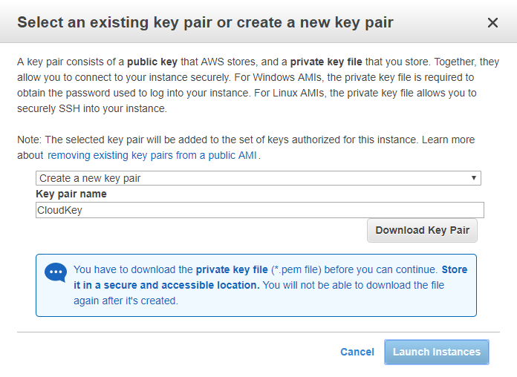
Key-Pair Creation
Select Create a new key pair
Enter key pair name(e.g. CloudKey)
Click Download Key Pair
Key (.pem) will be downloaded

Slide 15
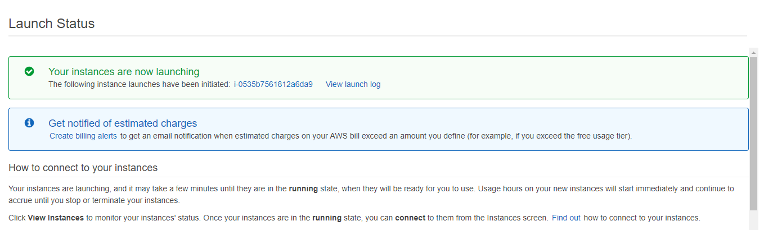
Launch Status
Click instance id(e.g. i-0535b7…)

Slide 16
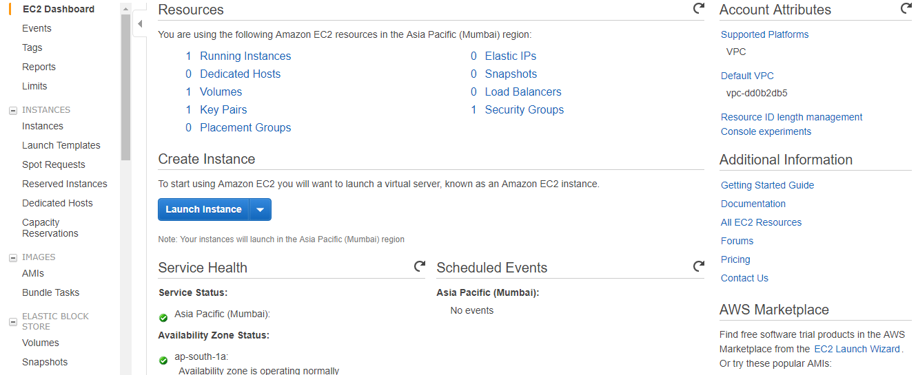
EC2 Dashboard
Click Running Instances link

Slide 17
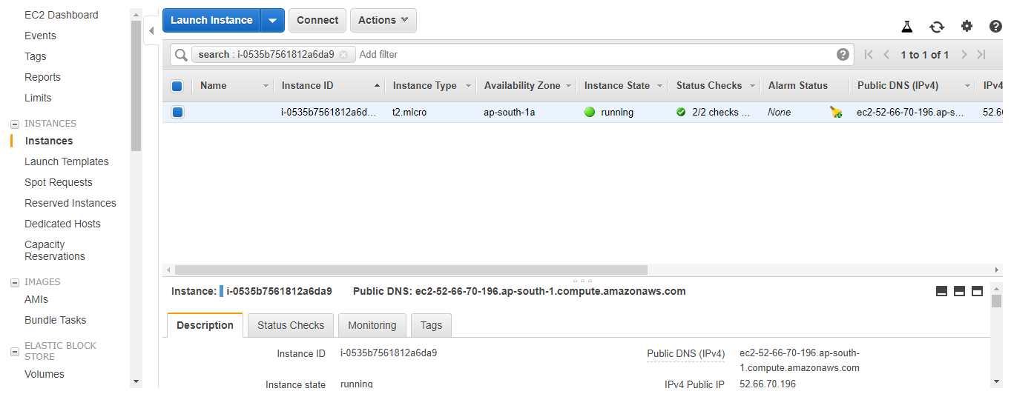
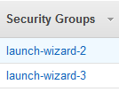
Running Instance
Drag the page from left to right, you will find Security Groups section
Click Security Groups link(e.g. launch-wizard-2)
You will navigate to Inbound section(next slide)

Slide 18
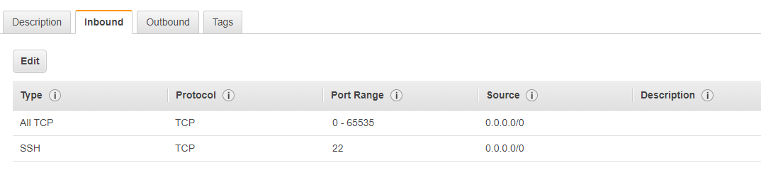
Create an In-bound rule on AWS
Click Edit
Add 2 rules(All TCP)
Note: SSH rule will be shown in the list default
Save

Slide 19
Running Instance
Come back to running instance page
Click Connect

Slide 20
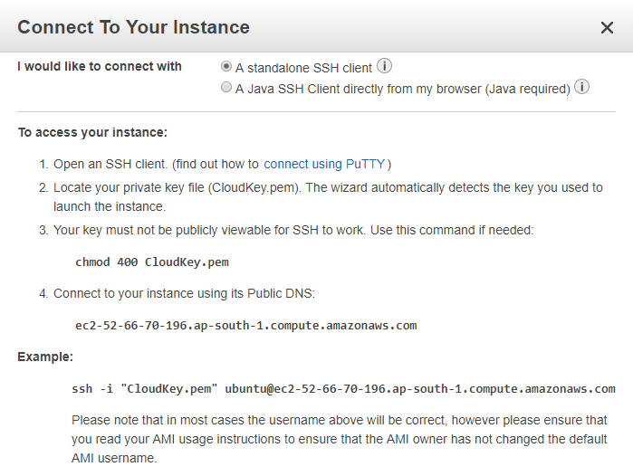
Connecting To Instance
We will use PuTTy to access AWS instance

Slide 21
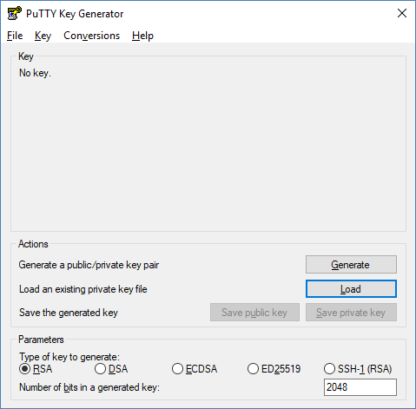
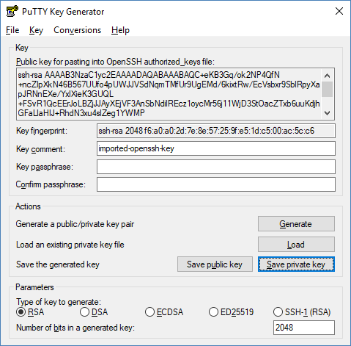
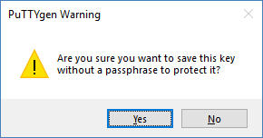
Using Puttygen to Import Key
Launch puttygen.exe
Click Load
Browse key(.pem) from machine
Click Save private key
Click Yes on pop-up
Browse the location
(e.g. C:\DO-United\Tools\) where you want to save new key(.ppk) & Save it
Close Putty Key Generator window

Slide 22
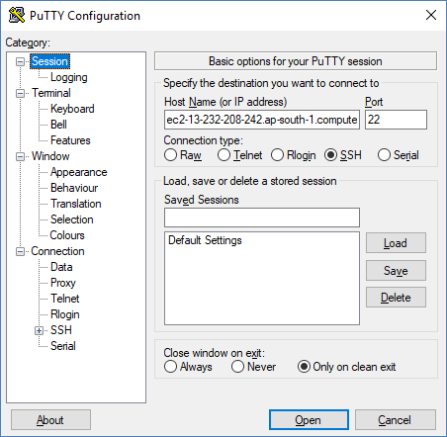
Using Putty to Connect
Launch putty.exe
Go to Session
Enter AWS Host Name or IP address(e.g. Ec2-13-233…)
Note: AWS Host name / IP address will be available on your AWS web account

Slide 23
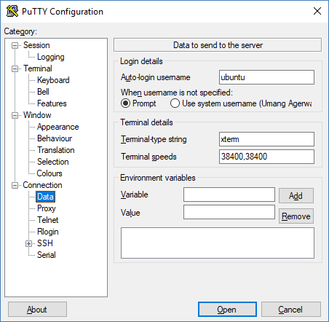
User → ubuntu/ec2-user
Go to Connection
Go to Data
Enter username(e.g. ubuntu/ec2-user) in Auto-login username section

Slide 24
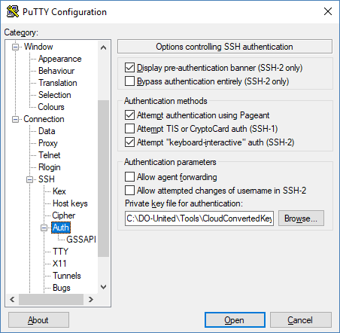
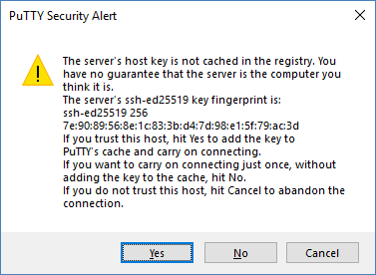
Selecting the Private Key
Go to SSH
Go to Auth
Browse key(.ppk) from machine
Click Open
Click Yes

Slide 25
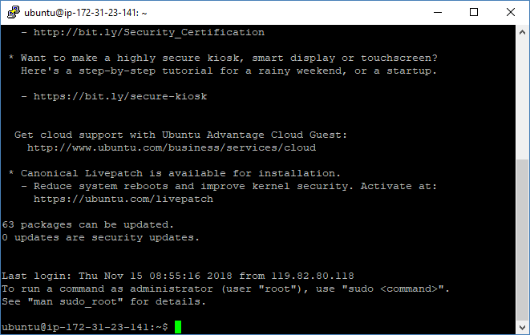
Connected to Putty

Slide 26
Install Docker on AWS server
If you create an Ubuntu instance on AWS, run following commands in terminal
sudo apt-get update
sudo apt-get install docker.io
docker --version

Slide 27
Run the container on AWS server
sudo docker run --rm -u root -p 8089:8089 -p 8080:8080 -v jenkins-data:/var/jenkins_home -v /var/run/docker.sock:/var/run/docker.sock -v $HOME:/home veritycorp/devops

Slide 28
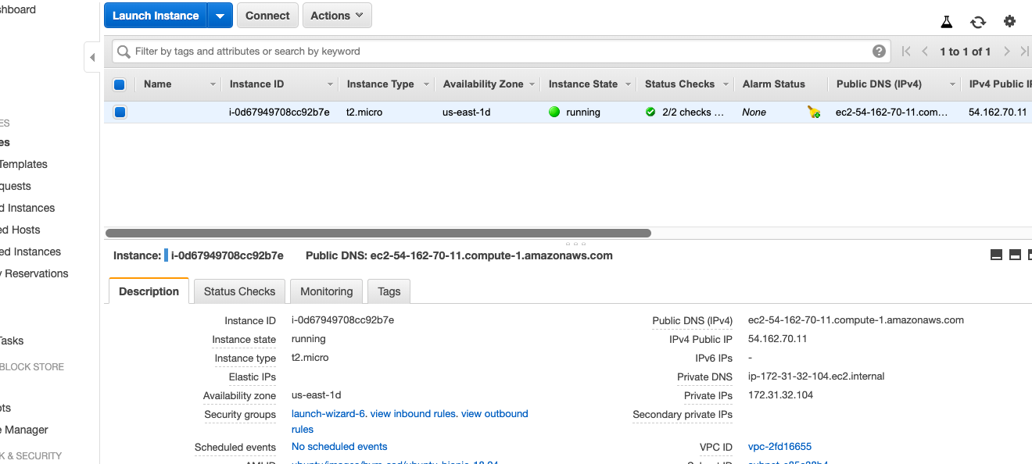
Capture the Public DNS/IP Address of the AWS Instance

Slide 29
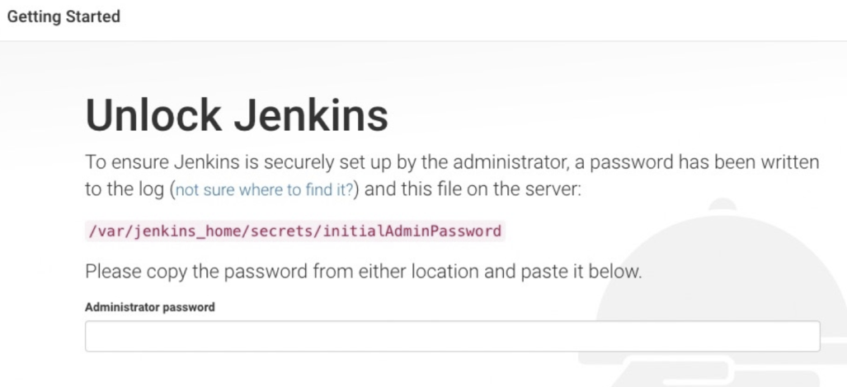
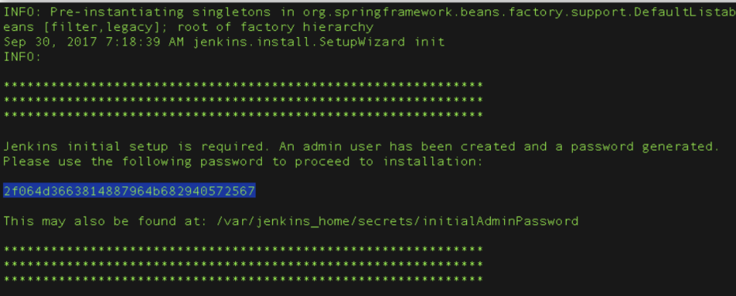
Unlocking Jenkis
After the 2 sets of asterisks appear in the terminal/command prompt window, browse to http://<<IP Address>>:8080 and wait until the Unlock Jenkins page appears
This is the same IP which we captured in the previous slide
From the terminal/command prompt window again, copy the automatically-generated alphanumeric password (between the 2 sets of asterisks)
On Customize Jenkins page click Install suggested plugins
IF YOU ARE RUNNING ALL THIS SECOND TIME then password will not be available on the screen. See next slide for recovering the password

Slide 30
Getting Jenkins Password
sudo docker container ls
sudo docker exec -it <container id> /bin/bash
cat /var/jenkins_home/secrets/initialAdminPassword

Slide 31
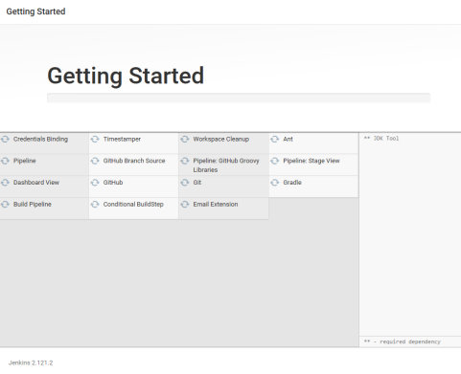
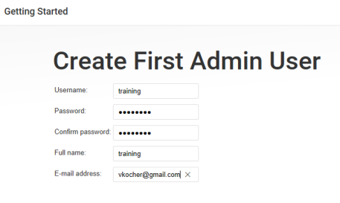
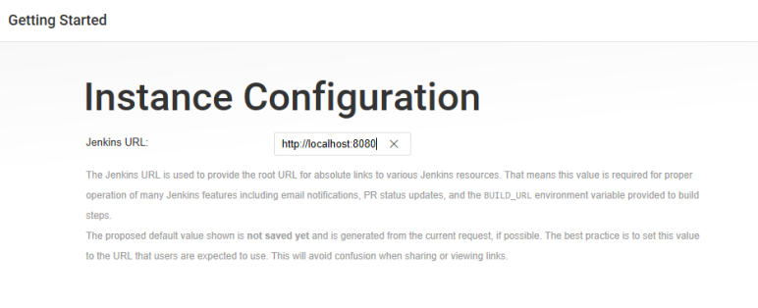
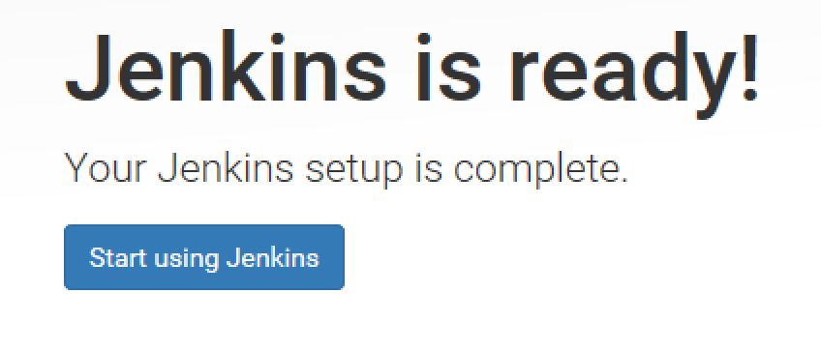
Getting Started
When the Create First Admin User page appears, specify your details in the respective fields and click Save and Finish.
When the Jenkins is ready page appears, click Start using Jenkins.
Please note
This page may indicate Jenkins is almost ready! instead and if so, click Restart.
If the page doesn’t automatically refresh after a minute, use your web browser to refresh the page manually.
If required, log in to Jenkins with the credentials of the user you just created and you’re ready to start using Jenkins!
you can stop the Docker container by typing Ctrl-C

Slide 32
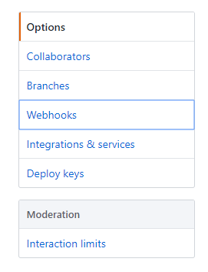
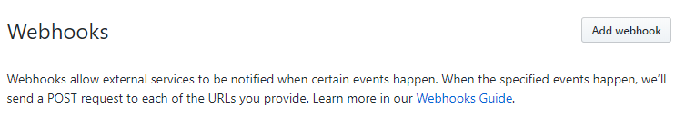
Setup Webhook on GitHub
Go to GitHub Web
Go to “verity-devops” repository
Navigate to the "Settings" tab
Select the "Webhooks" option on the left menu
Click "Add webhook"

Slide 33
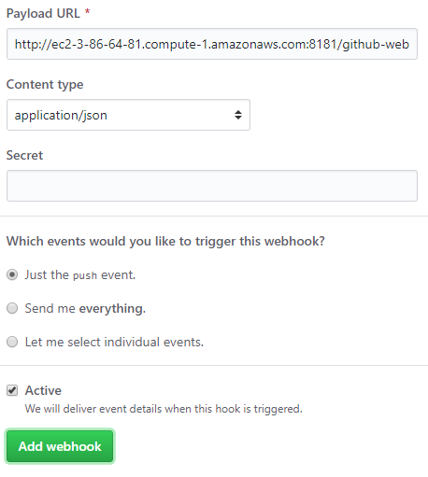
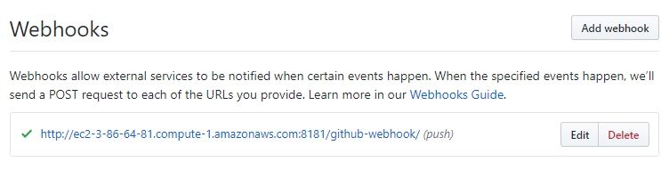
GitHub Settings
For "Payload URL":
Use the address for the aws server instance (e.g. http://ec2-3-86-64-81.compute-1.amazonaws.com:8080/)
Add /github-webhook/ to the end of it example: http://ec2-3-86-64-81.compute-1.amazonaws.com:8080/github-webhook/
Select "application/json" as the encoding type
Leave "Secret" blank (unless a secret has been created and configured in the Jenkins "Configure System -> GitHub plugin" section)
Select “Just the push event"
Make sure "Active" is checked
Click "Add Webhook"

Slide 34
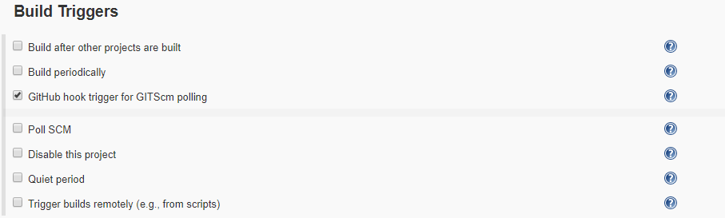
Create Pipeline Project
Go to Jenkins Dashboard
Click “New Item” at top left section
Enter item name(e.g. verity-devops) > Select Pipeline > Click OK
Select ”GitHub hook trigger for GITScm polling” checkbox under Build Triggers section
Go to Pipeline section
Choose the ”Pipeline script from SCM” option from the ”Definition” field
Choose the ”Git” option from the ”SCM” field
Enter your Repository URL(e.g. https://github.com/<Your username>/verity-devops )
Enter “Jenkinsfile.txt” under “Script Path” section
Click Apply
Click Save

Slide 35
Run Pipeline Project
Make some changes in code on GitHub
Pipeline project will be triggered automatically on Jenkins, once you make any changes on GitHub
Note: GitHub Webhook may take some time to be connected with Jenkins

Slide 36
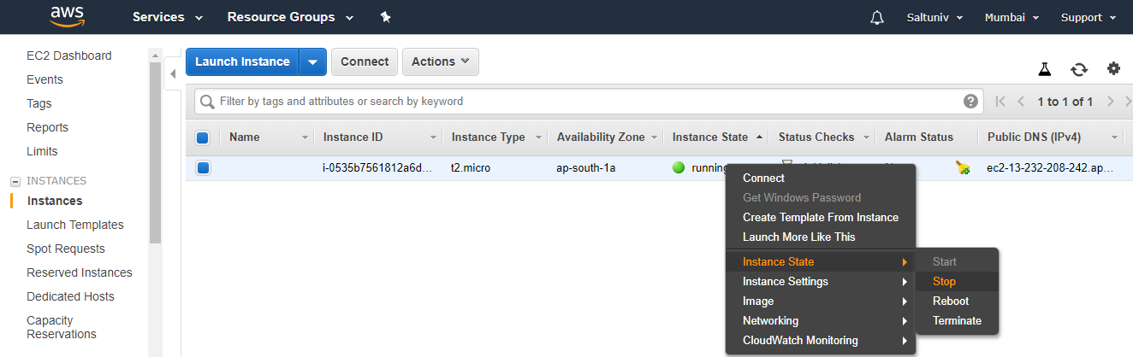
Stop the Instance once you are done with your work

